Slide 1
Search Engine Optimization (SEO)
Prepared by: Srishti Sharma

Slide 2

Search Engine
A search engine is a software system designed to search out the information from world wide web according to the user’s query.
Importance of search engine:
Brings visitors to our sites
Builds trust with users
Without search engine, we have to memorize the correct URLs of each websites in order to gather information. And we also have to memorize which information is in which website.

Slide 3






Top search engines:
Google, Yahoo, Bing, Baidu, Yandex, DuckDuckGo(For security),etc.

Slide 4
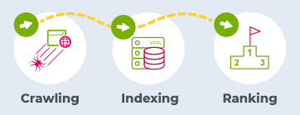
How search engine works?
Crawler/Spider: It observes the data or information of any websites immediately after their creation and stores that data to local store before user searches about it.
Indexers: It does the indexing of data collected by crawler in local server. It then divides those data into different categories which helps search engines to provide relevant result to the users.
Ranking algorithm: When user does any queries, ranking algorithm searches for the most relevant data according to user’s query and provide it to the user. It also decides which content should be ranked in top.

Slide 5
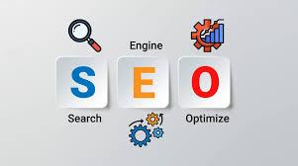
What is SEO?
SEO stands for Search Engine Optimization.
SEO is the process of making your website/web pages better for search engines, so that it can rank higher. In SEO we do not optimize search engines but we optimize our websites/web pages. We optimize our website in such way that when user searches some related keyword, our website appears on top.

Slide 6
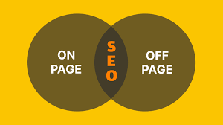
Types of SEO
On-page SEO:
On-page SEO refers to optimizing the parts of your website you control like Content, HTML, Title of page, URL, etc. It includes techniques like:
HTML file optimization,
Content optimization(keyword rich content),
URLs optimization,
Images optimization,
Technical aspects of websites, etc.
Off-page SEO:
Off-page SEO focuses on the ranking factors that occur outside of your website like brand mentions and backlinks. It is that optimization that we do going outside out websites or servers. It includes techniques like:
Creating backlink (Copying URLs of one website to another),
Domain authority,
Social links,
Forum submission, etc.

Slide 7

What is technical SEO? It can also be called as a part of on-page. It is used for better crawling and better indexing. To make these better, it is very important to improve the technical aspects of our website. It includes the techniques like:
web page speed/load time,
structure of website,
Sitemap,
Redirect pages,
Mobile friendly, etc.

Slide 8
Techniques of SEO
White-hat SEO
Black-hat SEO
It is also called Ethical SEO or Organic SEO. White hat SEO includes optimizing your website following the restrictions imposed by search engines. It focus on human audience giving them better results. It includes:
Content optimization,
Quality content,
Relevant internal links,
Relevant backlinks,
Sitemaps,
Technical aspects,
Better UX, etc.
It is also called Unethical SEO. Black hat SEO includes unethical techniques which are disapproved by search engines. If we use it, our website goes to blacklist which will be big loss for us. It includes:
Keyword stuffing,
Duplicate content,
Cloaking,
Hidden text or hidden links,
Link spamming,
Link farming, etc.

Slide 9

Grey hat: It is the composition of white hat and black hat. Mostly, we use white hat technique.

Slide 10
Thank You!

